Slide 1
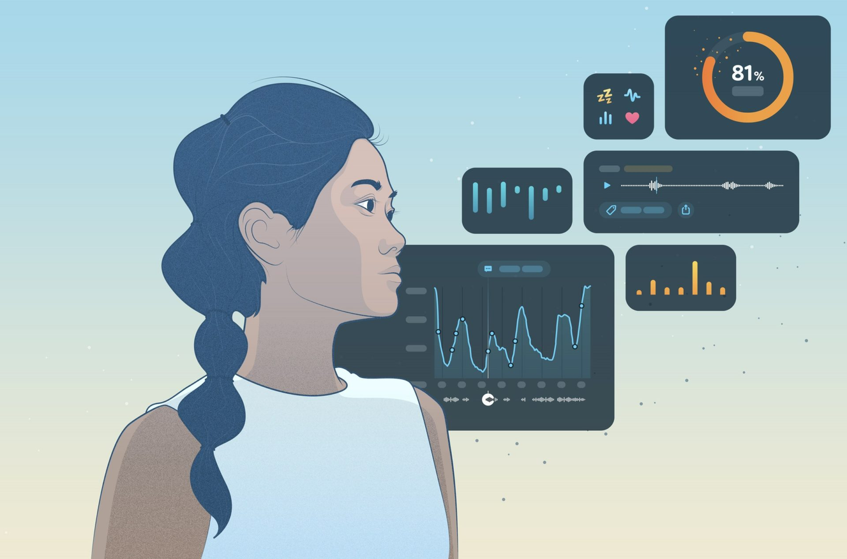

SMART PILLOW
GROUP 5

Slide 2
TABLE OF CONTENTS
01
GROUP MEMBERS
02
LITERATURE REVIEW
03
SUMMARY
04
DELIVERABLES
05
REFERENCES

Slide 3
Group - 5
NAME
ROLL NO.
Yukkta Seelam
Ankur Kumar
Batta Soumith
Manas
Ajeet
201167
200140
200264
200554
22111005

Slide 4
Importance of sleep
Sleep is a period of rest during which we relax our body and let our body regulate various bodily functions. Sleep is essential to us as it affects our mental and physical state and functioning. Sleep touches every aspect of the health of our body and is truly essential for our well-being. Sleep is vital for the proper development of their mind and body.
However, in today's chaotic world, it has become challenging to have a decent sleep schedule, and we have lately been neglecting our sleep hence, affecting our mental and physical well-being. Mental disorders like depression, stress, anxiety, etc., result from lack of proper sleep. People suffer from constant headaches and mental disorders, yet they refuse to change their sleep schedule. Recent studies show that a large proportion of adolescents lack proper sleep, and thus, we see them suffering from chronic mental disorders nowadays.

Slide 5
Literature Review
Here, we analyse the approaches taken by various other researchers and cite compare to our approach. We shall the most relevant papers of all the research paper that we read. Further we will compare these appraoches to our own and show how we differ from them.
The first research paper that we went through was the 'Sensor Pillow System.' As respiration, pulse, temperature, and blood pressure are the main physiological parameters that affect sleep hence the pillow system monitors respiration patterns and body movement with the aim of developing a less burdened and less constrained system easy to use for someone with no technical knowledge. The pillow contains a pressure bed distributed along the surface to monitor the respiration parameter.
The second research paper talks about a real-time adjustable pillow that monitors the sleep apnea of the user. The pillow checks for sleep apnea using a pulse oximeter and adjust the height and shape of the pillow accordingly in order to control the apnea. They use five bladders in the pillow to allow pillow reshaping. The bladders are located near the neck, side of head and a base bladder to support other bladders.

Slide 6
The third paper was a 'Smart Comfort Pillow,' which is appropriate for infants to comfort them using vibrations and monitor their movements. This pillow can help comfort infants when their parents are away and help them sleep by inducing heartbeat vibrations and measuring their PPG signals, and actively monitoring their movements.
The following research paper talks about a smart pillow system using temperature and humidity sensors to monitor the surrounding conditions while also observing the sleeping pattern of the user to deduce the ample environmental parameter for better sleep quality of that user.
One of the research papers that we went through talks about a pillow system using speakers to induce sleep in people suffering from insomnia and also has a massager embedded, which functions when the inbuilt alarm of the pillow goes off. This pillow uses a piezoelectric sensor to sense pressure and will only work when it detects any pressure on the pillow.

Slide 7
One of the research papers is about a smart pillow system built using IoT based system which helps monitor the stressfulness of users by observing sleep habits. Since the physiological parameters such as respiration, blood pressure, and temperature and non-physiological parameters such as sleeping hours and sleep positions vary a lot during different stages of sleep hence, this system helps monitor the various parameters for the person and also detects their stress levels.

Slide 8
The papers studied so far had the following flaws:
most of the pillow devices only gathered and presented the data instead of actuating it.
some of the implementations could be considered a breach of privacy.
usage may not be easy for people with no technical knowledge.
Some devices are not plug and play and hence are harder to use.

Slide 9
Summary
Smart Pillow
It is clear to us that sleep is very vital and can not be neglected. But, it is not possible for us all to have a very sound sleep every night. The room temperature might just not be right or you could have a habit of snoring. Many people across the world pay to visit a special sleep monitoring room in hospitals.
We have picked a smart pillow as our project to make sleep monitoring accessible to people. They wouldn't have to wait in order to visit the sleep monitoring rooms. This smart pillow helps monitor the room temperature using temperature sensors and can detect snoring using sensors.
Our idea of smart pillow includes sleep monitoring with respect to various physiological
factors like temperature, humidity, orientation of head, respiration patters, snoring , along with this we shall include a sound emitter for vibration induced sleep (VIS). We shall also include reshaping abilities to alliviate medical disorders related to sleep.

Slide 10
Deliverables
Gathering all the required sensors for each functionality.
Running a prototype to check the functionality of the same.
Testing and learning with different protocols to find the optimal.
Test an assembled prototype
The Final Model.

Slide 11
References
https://ieeexplore.ieee.org/stamp/stamp.jsp?tp=&arnumber=894630&tag=1
https://dl.acm.org/doi/abs/10.1145/2461381.2461405
https://ijartet.com/1532/v3s19kingsinternat/conference
https://www.semanticscholar.org/paper/Sensor-pillow-and-bed-sheet-system%3A- UnconstrainedLokaveePuntheeranurak/1da325bf57ac3cd706c60e772e3447fbbfe41b39
https://www.mdpi.com/1424-8220/18/11/3664
https://dl.acm.org/doi/abs/10.1145/3174910.3174954
https://www.semanticscholar.org/paper/An-IoT-based-smart-pillow-for-sleep-quality-in-AAL-Veiga-Garc%C3%ADa/628be3f5743955c3486bb1afb5f52431e85e205b
https://sites.google.com/view/laavanyarachakonda/publications-presentations
https://ieeexplore.ieee.org/stamp/stamp.jsp?tp=&arnumber=8364061
http://www.ijaema.com/gallery/249-ijaema-august-4503.pdf

